Slide 1

Chapter 2 Application Layer
A note on the use of these PowerPoint slides:
We’re making these slides freely available to all (faculty, students, readers). They’re in PowerPoint form so you see the animations; and can add, modify, and delete slides (including this one) and slide content to suit your needs. They obviously represent a lot of work on our part. In return for use, we only ask the following:
If you use these slides (e.g., in a class) that you mention their source (after all, we’d like people to use our book!)
If you post any slides on a www site, that you note that they are adapted from (or perhaps identical to) our slides, and note our copyright of this material.
For a revision history, see the slide note for this page.
Thanks and enjoy! JFK/KWR
All material copyright 1996-2020
J.F Kurose and K.W. Ross, All Rights Reserved
Computer Networking: A Top-Down Approach 8th edition n Jim Kurose, Keith Ross Pearson, 2020
Notes:
Version History
8.1. Updates throughout, including a lot more animations. These are the ppt files used to make Chapter 2 online lectures in Sept. 2020.
8.0 (April 2020)
All slides reformatted for 16:9 aspect ratio
All slides updated to 8th edition material
Use of Calibri font, rather that Gill Sans MT
Add LOTS more animation throughout

Slide 2

Application layer: overview
P2P applications
video streaming and content distribution networks
socket programming with UDP and TCP
Principles of network applications
Web and HTTP
E-mail, SMTP, IMAP
The Domain Name System DNS

Slide 3
Application layer: overview
Our goals:
conceptual and implementation aspects of application-layer protocols
transport-layer service models
client-server paradigm
peer-to-peer paradigm
learn about protocols by examining popular application-layer protocols and infrastructure
HTTP
SMTP, IMAP
DNS
video streaming systems, CDNs
programming network applications
socket API

Slide 4
Some network apps
social networking
Web
text messaging
e-mail
multi-user network games
streaming stored video (YouTube, Hulu, Netflix)
P2P file sharing
voice over IP (e.g., Skype)
real-time video conferencing (e.g., Zoom)
Internet search
remote login
…
Q: your favorites?

Slide 5
















Creating a network app
application
transport
network
data link
physical
write programs that:
run on (different) end systems
communicate over network
e.g., web server software communicates with browser software
no need to write software for network-core devices
network-core devices do not run user applications
applications on end systems allows for rapid app development, propagation
mobile network
national or global ISP
local or regional ISP
home network
content
provider
network
application
transport
network
data link
physical
application
transport
network
data link
physical
datacenter
network
enterprise
network

Slide 6
Client-server paradigm
server:
always-on host
permanent IP address
often in data centers, for scaling
clients:
contact, communicate with server
may be intermittently connected
may have dynamic IP addresses
do not communicate directly with each other
examples: HTTP, IMAP, FTP
mobile network
national or global ISP
local or regional ISP
home network
content
provider
network
datacenter
network
enterprise
network

Slide 7
Peer-peer architecture
no always-on server
arbitrary end systems directly communicate
peers request service from other peers, provide service in return to other peers
self scalability – new peers bring new service capacity, as well as new service demands
peers are intermittently connected and change IP addresses
complex management
example: P2P file sharing , torrent
mobile network
national or global ISP
local or regional ISP
home network
content
provider
network
datacenter
network
enterprise
network

Slide 8
Processes communicating
process: program running within a host
within same host, two processes communicate using inter-process communication (defined by OS)
processes in different hosts communicate by exchanging messages
clients, servers
client process: process that initiates communication
server process: process that waits to be contacted
note: applications with P2P architectures have client processes & server processes

Slide 9

Sockets
process sends/receives messages to/from its socket
socket analogous to door
sending process shoves message out door
sending process relies on transport infrastructure on other side of door to deliver message to socket at receiving process
two sockets involved: one on each side
application
socket
application
controlled by
app developer
process
process
transport
transport
network
network
controlled
by OS
link
Internet
link
physical
physical

Slide 10
Addressing processes
to receive messages, process must have identifier
host device has unique 32-bit IP address
Q: does IP address of host on which process runs suffice for identifying the process?
identifier includes both IP address and port numbers associated with process on host.
example port numbers:
HTTP server: 80
mail server: 25
to send HTTP message to gaia.cs.umass.edu web server:
IP address: 128.119.245.12
port number: 80
more shortly…
A: no, many processes can be running on same host

Slide 11
What transport service does an app need?
data integrity
some apps (e.g., file transfer, web transactions) require 100% reliable data transfer
other apps (e.g., audio) can tolerate some loss
throughput
some apps (e.g., multimedia) require minimum amount of throughput to be “effective”
other apps (“elastic apps”) make use of whatever throughput they get
timing
some apps (e.g., Internet telephony, interactive games) require low delay to be “effective”
security
encryption, data integrity, …

Slide 12
Transport service requirements: common apps
application
file transfer/download
e-mail
Web documents
real-time audio/video
streaming audio/video
interactive games
text messaging
data loss
no loss
no loss
no loss
loss-tolerant
loss-tolerant
loss-tolerant
no loss
throughput
elastic
elastic
elastic
audio: 5Kbps-1Mbps
video:10Kbps-5Mbps
same as above
Kbps+
elastic
time sensitive?
no
no
no
yes, 10’s msec
yes, few secs
yes, 10’s msec
yes and no

Slide 13
Internet transport protocols services
TCP service:
reliable transport between sending and receiving process
flow control: sender won’t overwhelm receiver
congestion control: throttle sender when network overloaded
connection-oriented: setup required between client and server processes
does not provide: timing, minimum throughput guarantee, security
UDP service:
unreliable data transfer between sending and receiving process
does not provide: reliability, flow control, congestion control, timing, throughput guarantee, security, or connection setup.
Q: why bother? Why is there a UDP?

Slide 14
Internet applications, and transport protocols
application
layer protocol
FTP [RFC 959]
SMTP [RFC 5321]
HTTP 1.1 [RFC 7320]
SIP [RFC 3261], RTP [RFC 3550], or proprietary HTTP [RFC 7320], DASH
WOW, FPS (proprietary)
application
file transfer/download
e-mail
Web documents
Internet telephony
streaming audio/video
interactive games
transport protocol
TCP
TCP
TCP
TCP or UDP
TCP
UDP or TCP
Notes:
Request for Comments

Slide 15
An application-layer protocol defines:
types of messages exchanged,
e.g., request, response
message syntax:
what fields in messages & how fields are delineated
message semantics
meaning of information in fields
rules for when and how processes send & respond to messages
open protocols:
defined in RFCs, everyone has access to protocol definition
allows for interoperability
e.g., HTTP, SMTP
proprietary protocols:
e.g., Skype, Zoom

Slide 16
Application layer: overview
P2P applications
video streaming and content distribution networks
socket programming with UDP and TCP
Principles of network applications
Web and HTTP
E-mail, SMTP, IMAP
The Domain Name System DNS

Slide 17
Web and HTTP
First, a quick review…
web page consists of objects, each of which can be stored on different Web servers
object can be HTML file, JPEG image, Java applet, audio file,…
web page consists of base HTML-file which includes several referenced objects, each addressable by a URL, e.g.,
www.someschool.edu/someDept/pic.gif
host name
path name

Slide 18

HTTP overview
HTTP: hypertext transfer protocol
Web’s application-layer protocol
client/server model:
client: browser that requests, receives, (using HTTP protocol) and “displays” Web objects
server: Web server sends (using HTTP protocol) objects in response to requests
HTTP request
PC running
Firefox browser
HTTP response
HTTP request
server running
Apache Web
server
HTTP response
iPhone running
Safari browser

Slide 19
HTTP overview (continued)
HTTP uses TCP:
client initiates TCP connection (creates socket) to server, port 80
server accepts TCP connection from client
HTTP messages (application-layer protocol messages) exchanged between browser (HTTP client) and Web server (HTTP server)
TCP connection closed
HTTP is “stateless”
server maintains no information about past client requests
aside
protocols that maintain “state” are complex!
past history (state) must be maintained
if server/client crashes, their views of “state” may be inconsistent, must be reconciled

Slide 20
HTTP connections: two types
Non-persistent HTTP
TCP connection opened
at most one object sent over TCP connection
TCP connection closed
downloading multiple objects required multiple connections
Persistent HTTP
TCP connection opened to a server
multiple objects can be sent over single TCP connection between client, and that server
TCP connection closed

Slide 21
Non-persistent HTTP: example
User enters URL:
www.someSchool.edu/someDepartment/home.index
(containing text, references to 10 jpeg images)
1a. HTTP client initiates TCP connection to HTTP server (process) at www.someSchool.edu on port 80
1b. HTTP server at host www.someSchool.edu waiting for TCP connection at port 80 “accepts” connection, notifying client
2. HTTP client sends HTTP request message (containing URL) into TCP connection socket. Message indicates that client wants object someDepartment/home.index
3. HTTP server receives request message, forms response message containing requested object, and sends message into its socket
time

Slide 22
Non-persistent HTTP: example (cont.)
User enters URL:
www.someSchool.edu/someDepartment/home.index
(containing text, references to 10 jpeg images)
4. HTTP server closes TCP connection.
5. HTTP client receives response message containing html file, displays html. Parsing html file, finds 10 referenced jpeg objects
6. Steps 1-5 repeated for each of 10 jpeg objects
time

Slide 23
Non-persistent HTTP: response time
RTT (definition): time for a small packet to travel from client to server and back
HTTP response time (per object):
one RTT to initiate TCP connection
one RTT for HTTP request and first few bytes of HTTP response to return
obect/file transmission time
initiate TCP
connection
RTT
request file
RTT
time to
transmit
file
file received
time
time
Non-persistent HTTP response time = 2RTT+ file transmission time
Notes:
Round-trip time

Slide 24
Persistent HTTP (HTTP 1.1)
Non-persistent HTTP issues:
requires 2 RTTs per object
OS overhead for each TCP connection
browsers often open multiple parallel TCP connections to fetch referenced objects in parallel
Persistent HTTP (HTTP1.1):
server leaves connection open after sending response
subsequent HTTP messages between same client/server sent over open connection
client sends requests as soon as it encounters a referenced object
as little as one RTT for all the referenced objects (cutting response time in half)

Slide 25
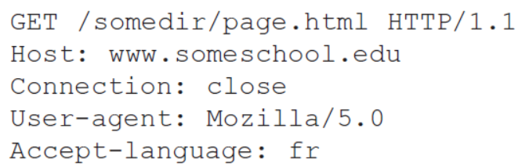
HTTP request message

Slide 26
HTTP request message
two types of HTTP messages: request, response
HTTP request message:
ASCII (human-readable format)
carriage return character
request line (GET, POST,
HEAD commands)
line-feed character
GET /index.html HTTP/1.1\r\n
Host: www-net.cs.umass.edu\r\n
User-Agent: Mozilla/5.0 (Macintosh; Intel Mac OS X 10.15; rv:80.0) Gecko/20100101 Firefox/80.0 \r\n
Accept: text/html,application/xhtml+xml\r\n
Accept-Language: en-us,en;q=0.5\r\n
Accept-Encoding: gzip,deflate\r\n
Connection: keep-alive\r\n
\r\n
header
lines
carriage return, line feed at start of line indicates end of header lines
* Check out the online interactive exercises for more examples: http://gaia.cs.umass.edu/kurose_ross/interactive/

Slide 27
HTTP request message: general format
method
sp
URL
sp
version
cr
lf
request
line
header field name
value
cr
lf
~
~
header
lines
~
~
header field name
value
cr
lf
cr
lf
~
entity body
~
body
~
~

Slide 28
Other HTTP request messages
POST method:
web page often includes form input
user input sent from client to server in entity body of HTTP POST request message
HEAD method:
requests headers (only) that would be returned if specified URL were requested with an HTTP GET method.
PUT method:
uploads new file (object) to server
completely replaces file that exists at specified URL with content in entity body of POST HTTP request message
GET method (for sending data to server):
include user data in URL field of HTTP GET request message (following a ‘?’):
www.somesite.com/animalsearch?monkeys&banana

Slide 29
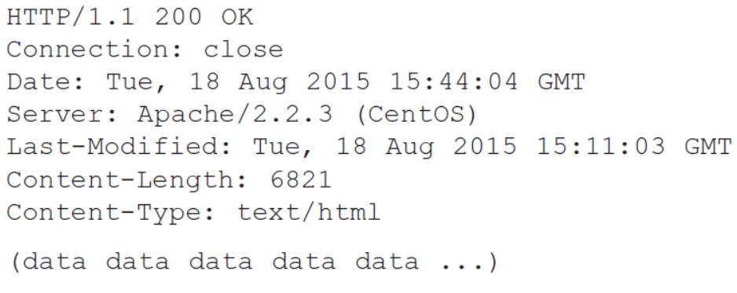
HTTP response message

Slide 30
HTTP response message
status line (protocol
status code status phrase)
HTTP/1.1 200 OK
Date: Tue, 08 Sep 2020 00:53:20 GMT
Server: Apache/2.4.6 (CentOS) OpenSSL/1.0.2k-fips PHP/7.4.9 mod_perl/2.0.11 Perl/v5.16.3
Last-Modified: Tue, 01 Mar 2016 18:57:50 GMT
ETag: "a5b-52d015789ee9e"
Accept-Ranges: bytes
Content-Length: 2651
Content-Type: text/html; charset=UTF-8
\r\n
data data data data data ...
header
lines
data, e.g., requested
HTML file
* Check out the online interactive exercises for more examples: http://gaia.cs.umass.edu/kurose_ross/interactive/

Slide 31
HTTP response status codes
status code appears in 1st line in server-to-client response message.
some sample codes:
200 OK
request succeeded, requested object later in this message
301 Moved Permanently
requested object moved, new location specified later in this message (in Location: field)
400 Bad Request
request msg not understood by server
404 Not Found
requested document not found on this server
505 HTTP Version Not Supported

Slide 32
Maintaining user/server state: cookies
Web sites and client browser use cookies to maintain some state between transactions
four components:
1) cookie header line of HTTP response message
2) cookie header line in next HTTP request message
3) cookie file kept on user’s host, managed by user’s browser
4) back-end database at Web site
Example:
Susan uses browser on laptop, visits specific e-commerce site for first time
when initial HTTP requests arrives at site, site creates:
unique ID (aka “cookie”)
entry in backend database for ID
subsequent HTTP requests from Susan to this site will contain cookie ID value, allowing site to “identify” Susan
Notes:
t’

Slide 33
Maintaining user/server state: cookies
client
server
ebay 8734
usual HTTP request msg
Amazon server
creates ID
1678 for user
cookie file
usual HTTP response
set-cookie: 1678
backend
database
create
entry
ebay 8734
amazon 1678
usual HTTP request msg
cookie: 1678
cookie-
specific
action
access
usual HTTP response msg
one week later:
access
ebay 8734
amazon 1678
usual HTTP request msg
cookie: 1678
cookie-
specific
action
usual HTTP response msg
time
time
Notes:
t’

Slide 34
HTTP cookies: comments
aside
What cookies can be used for:
authorization
shopping carts
recommendations
user session state (Web e-mail)
cookies and privacy:
cookies permit sites to learn a lot about you on their site.
third party persistent cookies (tracking cookies) allow common identity (cookie value) to be tracked across multiple web sites
Challenge: How to keep state?
at protocol endpoints: maintain state at sender/receiver over multiple transactions
in messages: cookies in HTTP messages carry state
Notes:
t’

Slide 35

Web caches
Goal: satisfy client requests without involving origin server
user configures browser to point to a (local) Web cache
browser sends all HTTP requests to cache
if object in cache: cache returns object to client
else cache requests object from origin server, caches received object, then returns object to client
Web
cache
HTTP request
HTTP request
client
HTTP response
HTTP response
origin
server
HTTP request
HTTP response
client
Notes:
t’

Slide 36


Web caches (aka proxy servers)
Web cache acts as both client and server
server for original requesting client
client to origin server
Why Web caching?
reduce response time for client request
cache is closer to client
reduce traffic on an institution’s access link
Internet is dense with caches
enables “poor” content providers to more effectively deliver content
server tells cache about object’s allowable caching in response header:
Notes:
re: poor content providers – like in real-estate, location is everything. servers want to be close to clients.

Slide 37

Option 1: buy a faster access link
Scenario:
access link rate: 1.54 Mbps
RTT from institutional router to server: 2 sec
web object size: 100K bits
average request rate from browsers to origin servers: 15/sec
avg data rate to browsers: 1.50 Mbps
154 Mbps
origin
servers
public
Internet
154 Mbps
1.54 Mbps
access link
Performance:
access link utilization = .97
LAN utilization: .0015
end-end delay = Internet delay +
access link delay + LAN delay
= 2 sec + minutes + usecs
.0097
institutional
network
1 Gbps LAN
Cost: faster access link (expensive!)
msecs
Notes:
t’

Slide 38
Option 2: install a web cache
Scenario:
access link rate: 1.54 Mbps
RTT from institutional router to server: 2 sec
web object size: 100K bits
average request rate from browsers to origin servers: 15/sec
avg data rate to browsers: 1.50 Mbps
origin
servers
public
Internet
1.54 Mbps
access link
Cost: web cache (cheap!)
institutional
network
Performance:
LAN utilization: .?
access link utilization = ?
average end-end delay = ?
1 Gbps LAN
How to compute link
utilization, delay?
local web cache
Notes:
t’

Slide 39
Calculating access link utilization, end-end delay with cache:
suppose cache hit rate is 0.4:
40% requests served by cache, with low (msec) delay
origin
servers
public
Internet
60% requests satisfied at origin
rate to browsers over access link
= 0.6 * 1.50 Mbps = .9 Mbps
access link utilization = 0.9/1.54 = .58 means low (msec) queueing delay at access link
1.54 Mbps
access link
institutional
network
average end-end delay:
= 0.6 * (delay from origin servers)
+ 0.4 * (delay when satisfied at cache)
= 0.6 (2.01) + 0.4 (~msecs) = ~ 1.2 secs
1 Gbps LAN
local web cache
lower average end-end delay than with 154 Mbps link (and cheaper too!)
Notes:
t’

Slide 40
The Conditional GET
First, on the behalf of a requesting browser, a proxy cache sends a request message to a Web server:
GET /fruit/kiwi.gif HTTP/1.1
Host: www.exotiquecuisine.com
Second, the Web server sends a response message with the requested object to the cache:
HTTP/1.1 200 OK
Date: Sat, 3 Oct 2015 15:39:29
Server: Apache/1.3.0 (Unix)
Last-Modified: Wed, 9 Sep 2015 09:23:24
Content-Type: image/gif!
(data data data data data ...)

Slide 41
The Conditional GET
Third, one week later, another browser requests the same object via the cache, and the object is still in the cache.
Since this object may have been modified at the Web server in the past week, the cache performs an up-to-date check by issuing a conditional GET.
GET /fruit/kiwi.gif HTTP/1.1
Host: www.exotiquecuisine.com
If-modified-since: Wed, 9 Sep 2015 09:23:24
This conditional GET is telling the server to send the object only if the object has been modified since the specified date.
Fourth, the Web server sends a response message to the cache:
HTTP/1.1 304 Not Modified
Date: Sat, 10 Oct 2015 15:39:29
Server: Apache/1.3.0 (Unix)!
(empty entity body)
Last response message has 304 Not Modified in the status line, which tells the cache that it can go ahead and forward its (the proxy cache’s) cached copy of the object to the requesting browser.

Slide 42
Application layer: overview
P2P applications
video streaming and content distribution networks
socket programming with UDP and TCP
Principles of network applications
Web and HTTP
E-mail, SMTP, IMAP
The Domain Name System DNS

Slide 43
E-mail
user
agent
Three major components:
user agents
mail servers
simple mail transfer protocol: SMTP
User Agent
a.k.a. “mail reader”
composing, editing, reading mail messages
e.g., Outlook, iPhone mail client
outgoing, incoming messages stored on server
mail
server
user
agent
SMTP
mail
server
user
agent
SMTP
SMTP
user
agent
mail
server
user
agent
user
agent
outgoing
message queue
user mailbox

Slide 44
E-mail: mail servers
user
agent
mail servers:
mailbox contains incoming messages for user
message queue of outgoing (to be sent) mail messages
SMTP protocol between mail servers to send email messages
client: sending mail server
“server”: receiving mail server
mail
server
user
agent
SMTP
mail
server
user
agent
SMTP
SMTP
user
agent
mail
server
user
agent
user
agent
outgoing
message queue
user mailbox

Slide 45
SMTP RFC (5321)
“client”
SMTP server
“server”
SMTP server
uses TCP to reliably transfer email message from client (mail server initiating connection) to server, port 25
direct transfer: sending server (acting like client) to receiving server
three phases of transfer
SMTP handshaking (greeting)
SMTP transfer of messages
SMTP closure
command/response interaction (like HTTP)
commands: ASCII text
response: status code and phrase
initiate TCP
connection
RTT
TCP connection
initiated
220
SMTP handshaking
HELO
250 Hello
SMTP transfers
time

Slide 46


Scenario: Alice sends e-mail to Bob
1) Alice uses UA to compose e-mail message “to” bob@someschool.edu
4) SMTP client sends Alice’s message over the TCP connection
2) Alice’s UA sends message to her mail server using SMTP; message placed in message queue
5) Bob’s mail server places the message in Bob’s mailbox
3) client side of SMTP at mail server opens TCP connection with Bob’s mail server
6) Bob invokes his user agent to read message
user
agent
mail
server
user
agent
1
mail
server
2
3
6
4
Alice’s mail server
5
Bob’s mail server

Slide 47
Mail message format
SMTP: protocol for exchanging e-mail messages, defined in RFC 5321 (like RFC 7231 defines HTTP)
RFC 2822 defines syntax for e-mail message itself (like HTML defines syntax for web documents)
header lines, e.g.,
To:
From:
Subject:
these lines, within the body of the email message area different from SMTP MAIL FROM:, RCPT TO: commands!
Body: the “message” , ASCII characters only
header
blank
line
body

Slide 48
Retrieving email: mail access protocols
user
agent
e-mail access
protocol
user
agent
SMTP
SMTP
(e.g., IMAP, HTTP)
sender’s e-mail
server
receiver’s e-mail
server
SMTP: delivery/storage of e-mail messages to receiver’s server
mail access protocol: retrieval from server
IMAP: Internet Mail Access Protocol [RFC 3501]: messages stored on server, IMAP provides retrieval, deletion, folders of stored messages on server
HTTP: gmail, Hotmail, Yahoo!Mail, etc. provides web-based interface on top of STMP (to send), IMAP (or POP) to retrieve e-mail messages

Slide 49
Application Layer: Overview
P2P applications
video streaming and content distribution networks
socket programming with UDP and TCP
Principles of network applications
Web and HTTP
E-mail, SMTP, IMAP
The Domain Name System DNS

Slide 50
DNS: Domain Name System
people: many identifiers:
SSN, name, passport #
Internet hosts, routers:
IP address (32 bit) - used for addressing datagrams
“name”, e.g., cs.umass.edu - used by humans
Q: how to map between IP address and name, and vice versa ?
Domain Name System (DNS):
distributed database implemented in hierarchy of many name servers
application-layer protocol: hosts, DNS servers communicate to resolve names (address/name translation)
note: core Internet function, implemented as application-layer protocol
complexity at network’s “edge”

Slide 51
DNS: services, structure
DNS services:
hostname-to-IP-address translation
host aliasing
canonical, alias names
mail server aliasing
load distribution
replicated Web servers: many IP addresses correspond to one name
Q: Why not centralize DNS?
single point of failure
traffic volume
distant centralized database
maintenance
A: doesn‘t scale!
Comcast DNS servers alone: 600B DNS queries/day
Akamai DNS servers alone: 2.2T DNS queries/day

Slide 52

Thinking about the DNS
humongous distributed database:
~ billion records, each simple
handles many trillions of queries/day:
many more reads than writes
performance matters: almost every Internet transaction interacts with DNS - msecs count!
organizationally, physically decentralized:
millions of different organizations responsible for their records
“bulletproof”: reliability, security

Slide 53
DNS: a distributed, hierarchical database
Root DNS Servers
Root
…
…
.com DNS servers
.org DNS servers
.edu DNS servers
Top Level Domain
…
…
…
…
yahoo.com
DNS servers
amazon.com
DNS servers
pbs.org
DNS servers
nyu.edu
DNS servers
umass.edu
DNS servers
Authoritative
Client wants IP address for www.amazon.com; 1st approximation:
client queries root server to find .com DNS server
client queries .com DNS server to get amazon.com DNS server
client queries amazon.com DNS server to get IP address for www.amazon.com

Slide 54
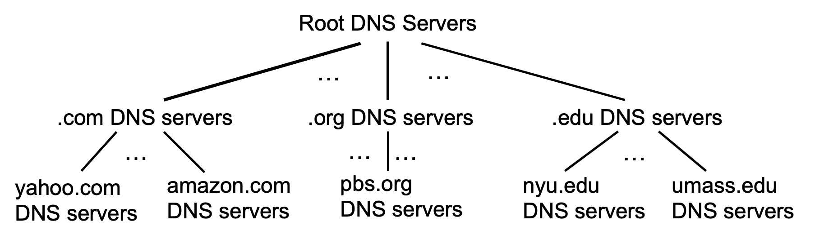
DNS: root name servers
official, contact-of-last-resort by name servers that can not resolve name

Slide 55
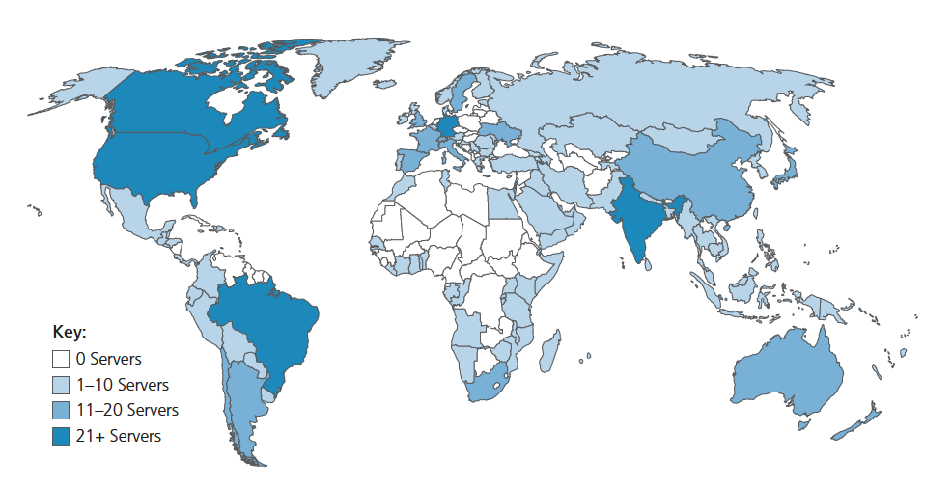
DNS: root name servers
official, contact-of-last-resort by name servers that can not resolve name
incredibly important Internet function
Internet couldn’t function without it!
DNSSEC – provides security (authentication, message integrity)
ICANN (Internet Corporation for Assigned Names and Numbers) manages root DNS domain
13 logical root name “servers” worldwide each “server” replicated many times (~200 servers in US)

Slide 56
Top-Level Domain, and authoritative servers
Top-Level Domain (TLD) servers:
responsible for .com, .org, .net, .edu, .aero, .jobs, .museums, and all top-level country domains, e.g.: .cn, .uk, .fr, .ca, .jp
Network Solutions: authoritative registry for .com, .net TLD
Educause: .edu TLD
authoritative DNS servers:
organization’s own DNS server(s), providing authoritative hostname to IP mappings for organization’s named hosts
can be maintained by organization or service provider

Slide 57
Local DNS name servers
when host makes DNS query, it is sent to its local DNS server
Local DNS server returns reply, answering:
from its local cache of recent name-to-address translation pairs (possibly out of date!)
forwarding request into DNS hierarchy for resolution
each ISP has local DNS name server; to find yours:
MacOS: % scutil --dns
Windows: >ipconfig /all
local DNS server doesn’t strictly belong to hierarchy

Slide 58
DNS security
DDoS attacks
bombard root servers with traffic
not successful to date
traffic filtering
local DNS servers cache IPs of TLD servers, allowing root server bypass
bombard TLD servers
potentially more dangerous
Spoofing attacks
intercept DNS queries, returning bogus replies
DNS cache poisoning
RFC 4033: DNSSEC authentication services

Slide 59
Application Layer: Overview
P2P applications
video streaming and content distribution networks
socket programming with UDP and TCP
Principles of network applications
Web and HTTP
E-mail, SMTP, IMAP
The Domain Name System DNS

Slide 60
Peer-to-peer (P2P) architecture
no always-on server
arbitrary end systems directly communicate
peers request service from other peers, provide service in return to other peers
self scalability – new peers bring new service capacity, and new service demands
peers are intermittently connected and change IP addresses
complex management
examples: P2P file sharing (BitTorrent), streaming (KanKan), VoIP (Skype)
mobile network
national or global ISP
local or regional ISP
home network
content
provider
network
datacenter
network
enterprise
network

Slide 61
File distribution: client-server vs P2P
Q: how much time to distribute file (size F) from one server to N peers?
peer upload/download capacity is limited resource
u_{s}: server upload capacity
d_{i}: peer i download capacity
file, size F
u₁
d₁
u₂
u_{s}
d₂
server
d_{i}
u_{N}
network (with abundant
bandwidth)
u_{i}
d_{N}
u_{i}: peer i upload capacity

Slide 62

P2P file distribution: BitTorrent
file divided into 256Kb chunks
peers in torrent send/receive file chunks
tracker: tracks peers
participating in torrent
torrent: group of peers exchanging chunks of a file
Alice arrives …
… obtains list
of peers from tracker
… and begins exchanging
file chunks with peers in torrent

Slide 63


P2P file distribution: BitTorrent
peer joining torrent:
has no chunks, but will accumulate them over time from other peers
registers with tracker to get list of peers, connects to subset of peers (“neighbors”)
while downloading, peer uploads chunks to other peers
peer may change peers with whom it exchanges chunks
churn: peers may come and go
once peer has entire file, it may (selfishly) leave or (altruistically) remain in torrent

Slide 64
BitTorrent: tit-for-tat
(1) Alice “optimistically unchokes” Bob
(2) Alice becomes one of Bob’s top-four providers; Bob reciprocates
(3) Bob becomes one of Alice’s top-four providers
higher upload rate: find better trading partners, get file faster !

Slide 65
Application layer: overview
P2P applications
video streaming and content distribution networks
socket programming with UDP and TCP
Principles of network applications
Web and HTTP
E-mail, SMTP, IMAP
The Domain Name System DNS

Slide 66




Video Streaming and CDNs: context
stream video traffic: major consumer of Internet bandwidth
Netflix, YouTube, Amazon Prime: 80% of residential ISP traffic (2020)
challenge: scale - how to reach ~1B users?
challenge: heterogeneity
different users have different capabilities (e.g., wired versus mobile; bandwidth rich versus bandwidth poor)
solution: distributed, application-level infrastructure

Slide 67

Multimedia: video
spatial coding example: instead of sending N values of same color (all purple), send only two values: color value (purple) and number of repeated values (N)
video: sequence of images displayed at constant rate
e.g., 24 images/sec
digital image: array of pixels
each pixel represented by bits
coding: use redundancy within and between images to decrease # bits used to encode image
spatial (within image)
temporal (from one image to next)
……………………..
……………….…….
frame i
temporal coding example: instead of sending complete frame at i+1, send only differences from frame i
frame i+1

Slide 68
Multimedia: video
spatial coding example: instead of sending N values of same color (all purple), send only two values: color value (purple) and number of repeated values (N)
CBR: (constant bit rate): video encoding rate fixed
VBR: (variable bit rate): video encoding rate changes as amount of spatial, temporal coding changes
examples:
MPEG 1 (CD-ROM) 1.5 Mbps
MPEG2 (DVD) 3-6 Mbps
MPEG4 (often used in Internet, 64Kbps – 12 Mbps)
……………………..
……………….…….
frame i
temporal coding example: instead of sending complete frame at i+1, send only differences from frame i
frame i+1

Slide 69


Streaming stored video
simple scenario:
Internet
video server
(stored video)
client
Main challenges:
server-to-client bandwidth will vary over time, with changing network congestion levels (in house, access network, network core, video server)
packet loss, delay due to congestion will delay playout, or result in poor video quality

Slide 70
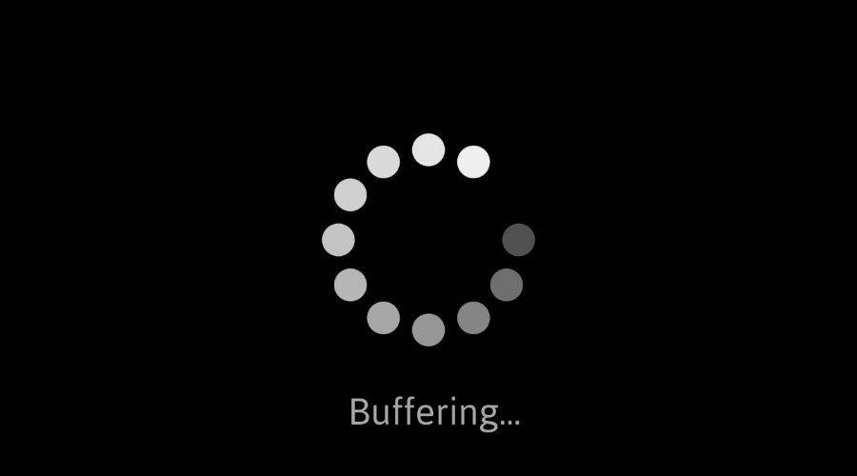
Streaming stored video: challenges
continuous playout constraint: during client video playout, playout timing must match original timing
… but network delays are variable (jitter), so will need client-side buffer to match continuous playout constraint
other challenges:
client interactivity: pause, fast-forward, rewind, jump through video
video packets may be lost, retransmitted

Slide 71
Application Layer: Overview
P2P applications
video streaming and content distribution networks
socket programming with UDP and TCP
Principles of network applications
Web and HTTP
E-mail, SMTP, IMAP
The Domain Name System DNS

Slide 72
Socket programming
goal: learn how to build client/server applications that communicate using sockets
socket: door between application process and end-end-transport protocol
application
socket
application
controlled by
app developer
process
process
transport
transport
network
network
controlled
by OS
link
Internet
link
physical
physical

Slide 73
Socket programming
Two socket types for two transport services:
UDP: unreliable datagram
TCP: reliable, byte stream-oriented
Application Example:
client reads a line of characters (data) from its keyboard and sends data to server
server receives the data and converts characters to uppercase
server sends modified data to client
client receives modified data and displays line on its screen

Slide 74
Socket programming with UDP
UDP: no “connection” between client and server:
no handshaking before sending data
sender explicitly attaches IP destination address and port # to each packet
receiver extracts sender IP address and port# from received packet
UDP: transmitted data may be lost or received out-of-order
Application viewpoint:
UDP provides unreliable transfer of groups of bytes (“datagrams”) between client and server processes

Slide 75
Client/server socket interaction: UDP
server (running on serverIP)
client
create socket:
create socket, port= x:
clientSocket =
socket(AF_INET,SOCK_DGRAM)
serverSocket =
socket(AF_INET,SOCK_DGRAM)
Create datagram with serverIP address
And port=x; send datagram via clientSocket
read datagram from
serverSocket
write reply to
serverSocket
specifying client address,
port number
read datagram from
clientSocket
close
clientSocket

Slide 76
Chapter 2: Summary
our study of network application layer is now complete!
application architectures
client-server
P2P
application service requirements:
reliability, bandwidth, delay
Internet transport service model
connection-oriented, reliable: TCP
unreliable, datagrams: UDP
specific protocols:
HTTP
SMTP, IMAP
DNS
P2P: BitTorrent
video streaming, CDNs
socket programming:
TCP, UDP sockets

Slide 77
Chapter 2: Summary
Most importantly: learned about protocols!
typical request/reply message exchange:
client requests info or service
server responds with data, status code
message formats:
headers: fields giving info about data
data: info(payload) being communicated
important themes:
centralized vs. decentralized
stateless vs. stateful
scalability
reliable vs. unreliable message transfer
“complexity at network edge”

Slide 78
Additional Chapter 2 slides
Notes:
Version History
7.01 (January 2020)
All slides reformatted for 16:9 aspect ratio
Use of Calibri font, rather that Gill Sans MT
Updated slide content for 2020 link technologies and applications
Add more animation throughout
New Master slide

Slide 79
Sample SMTP interaction
S: 220 hamburger.edu
C: HELO crepes.fr
S: 250 Hello crepes.fr, pleased to meet you
C: MAIL FROM: <alice@crepes.fr>
S: 250 alice@crepes.fr... Sender ok
C: RCPT TO: <bob@hamburger.edu>
S: 250 bob@hamburger.edu ... Recipient ok
C: DATA
S: 354 Enter mail, end with "." on a line by itself
C: Do you like ketchup?
C: How about pickles?
C: .
S: 250 Message accepted for delivery
C: QUIT
S: 221 hamburger.edu closing connection
Notes:
Retired this slide, since telnet isn’t really used anymore, and few non https: mail servers around anymore....

Slide 80
CDN content access: a closer look
Bob (client) requests video http://netcinema.com/6Y7B23V
video stored in CDN at http://KingCDN.com/NetC6y&B23V
1. Bob gets URL for video http://netcinema.com/6Y7B23V
from netcinema.com web page
2. resolve http://netcinema.com/6Y7B23V
via Bob’s local DNS
1
2
6. request video from
KINGCDN server,
streamed via HTTP
5
Bob’s
local DNS
server
netcinema.com
3. netcinema’s DNS returns CNAME for
http://KingCDN.com/NetC6y&B23V
4
3
netcinema’s
authoratative DNS
KingCDN.com
KingCDN
authoritative DNS
Notes:
This slide retired, since there’s the Netflix example which is visually better

Slide 81
Case study: Netflix
Amazon cloud
upload copies of multiple versions of video to CDN servers
CDN
server
Netflix registration,
accounting servers
Bob browses
Netflix video
Manifest file, requested
returned for
specific video
CDN
server
2
1
3
Bob manages Netflix account
CDN
server
4
DASH server selected, contacted, streaming begins
Notes:
This slide retired, since there’s the new Netflix example which is visually better

